Slide 1
Enquiring Minds: Early Detection of Rumors in Social Media from Enquiry Posts
Date: 2016/11/29
Author: Zhe Zhao, Paul Resnick, Qiaozhu Mei
Source: WWW’15
Advisor: Jia-Ling, Koh
Speaker: Bo-Wen, Jiang

Slide 2
Outline
•Introduction
•Method
•Experiment
•Conclusion

Slide 3
Introduction
What is Rumor?
“A rumor is a controversial and fact-checkable statement.”
Ex:
X 馬航MH370客機失蹤 (not controversial)
O 馬航MH370客機被找到了(controversial and fact-checkable )
X 我今天很快樂 (主觀感受，not fact-checkable)
X 柯P會參加2040的總統選舉 (not fact-checkable)

Slide 4
Introduction
Motive
Early Detection of Rumors , limiting their damage.
It is valuable to identify trending rumors as early as possible.
Ex:
The official Twitter account of the Associated Press (AP) was hacked. The hacked account sent out a tweet about “ two explosions in the White House and the President being injured.”

Slide 5
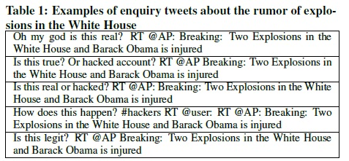
Introduction
Goal
an automated tool to identify potential Rumors in twitter from Enquiry Posts.

Slide 6
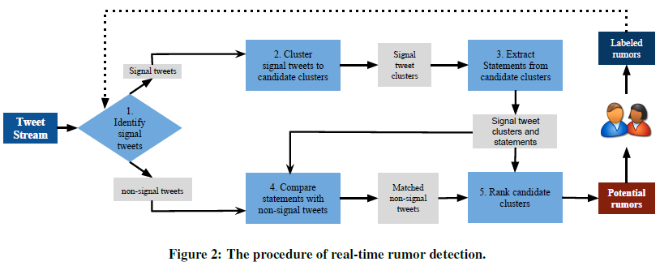
Introduction
Flow chart

Slide 7
Outline
•Introduction
•Method
•Experiment
•Conclusion

Slide 8
Method
Input Data
Tweet Stream
Tweet
Retweet
Per hour or per day
Not all enquiries are related to rumors [37].
those tweets that contain skeptical enquiries: verification questions and corrections. These are the signal tweets.
RUMOR
verification questions
corrections

Slide 9
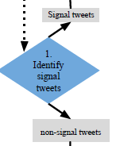
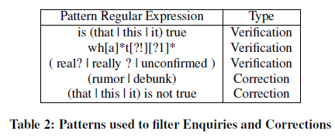
Method
1.Identify Signal Tweets.
Then it identifies a set of regular expressions that define the set of signal tweets
Verification
Corrrection

Slide 10
Method
Extracted lexical features
Using Porter Stemmer
All tweets are lowercased
the tweets: unigrams, bigrams and trigrams.
Stemming
Relevance test
Using Chi-Squared test
each feature in the data set (tweet) and class label of the patterns

Slide 11
Method
2. Identify Signal Clusters
Cluster the Similar Signal tweets
use the Jaccard coefficient to measure similarity between tweets.
use the Minhash algorithm reduce the dimensionality of the N gram vector space
the threshold 0.6

Slide 12
Method
3. Extract Statement from candidate clusters
Detect Statements
each candidate cluster, we extract the most frequent and continuous substrings
and output them in order as the summarized statement.
Next , we can match similar non-signal tweets from the tweet stream.

Slide 13
Method
4. Compare statements with Non-signal Tweets
Using Jaccard similarity
the statement that summarizes the tweets in a signal cluster
similar non-signal tweets from the tweet stream
the threshold 0.6

Slide 14
Method
5. Rank Candidate Rumor Clusters
Using SVM (support vector machines)
Using Decision Trees
Features (13) :
Percentage of signal tweets (1 feature)
Tweet lengths (3 features):
Retweets (2 features):
URLs (2 features):
Etc…..

Slide 15
Outline
•Introduction
•Method
•Experiment
•Conclusion

Slide 16
Experiment
Data Sets
two different collections of tweets
the Boston Marathon bombing in April 2013
30340218 tweets
a random month of the year 2013
Gardenhose access (10% sample of the stream of all tweets).
1242186946 tweets.

Slide 17
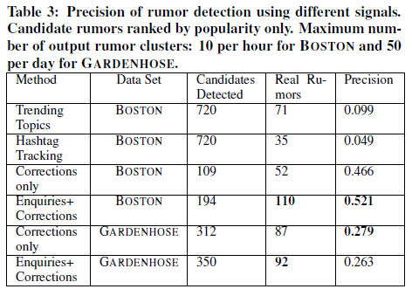
Experiment
Precision of Candidate Rumor Clusters

Slide 18
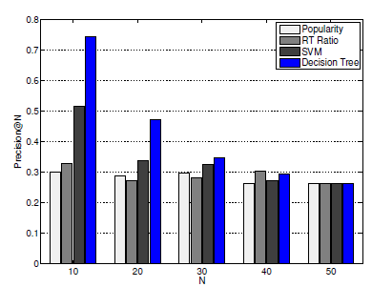
Experiment
Ranking Candidate Rumor Clusters

Slide 19
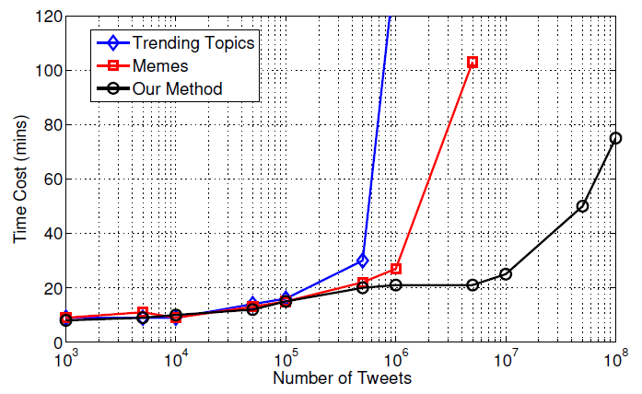
Experiment
Ranking Candidate Rumor Clusters

Slide 20
Outline
•Introduction
•Method
•Experiment
•Conclusion

Slide 21
Conclusion
First, we develop an algorithm for identifying newly emerging
Second, we identify a set of regular expressions that define the set of signal tweets. This crude classifier of signal tweets based on regular expression matching turns out to be sufficient.
Third, we identify features of signal clusters that are independent of any particular topic and that can be used to effectively rank the clusters by their likelihood of containing a disputed factual claim.

